Slide 1

Python Unit Testing
Life Choices Coding Academy 2020

Slide 2

Learning outcome:
By the end of this section, student should be able to:
Understand why code needs to be tested
Perform unit test(s) for their code base.
Practice test driven development.
Add basic Travis (CI) config file to their programs

Slide 3
Why Software testing
is important?
To plan for change and flexibility
To ensure that the application works as expected.
Notes:
To plan for change and flexibility, which is crucial if your code is going to survive even to the end of your own development process, it’s important to set up tests for the various parts of your program (so-called unit tests).
Rather than the intuitive “code a little, test a little” practice, the Extreme Programming crowd (a relatively new movement in software design and development) has introduced the highly useful, but somewhat counterintuitive, dictum “test a little, code a little.” In other words, test first and code later. (This is also known as test-driven programming.)
Give an example maybe about tesla accident and testing machine learning algorithm.
https://www.quora.com/Whats-the-best-way-to-test-machine-learning-code-How-do-we-know-its-running-as-we-assume-If-the-correction-is-low-how-could-you-know-if-it%E2%80%99s-caused-by-an-inappropriately-used-algorithm-or-just-bad-implementation-of-it

Slide 4
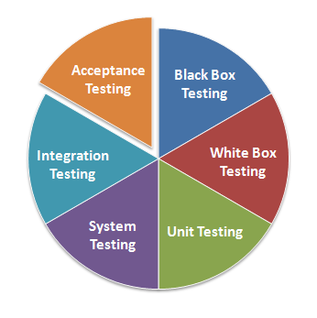
What can be tested?
Requirements
Design
Interfaces
Code / Implementation
Documentation
Conventions
Writing tests is mandatory for good software.
Notes:
To plan for change and flexibility, which is crucial if your code is going to survive even to the end of your own development process, it’s important to set up tests for the various parts of your program (so-called unit tests).
Rather than the intuitive “code a little, test a little” practice, the Extreme Programming crowd (a relatively new movement in software design and development) has introduced the highly useful, but somewhat counterintuitive, dictum “test a little, code a little.” In other words, test first and code later. (This is also known as test-driven programming.)

Slide 5
Test Driven Development
The process of implementing code by writing your tests first, seeing them fail, then writing the code to make the test(s) pass.
Write Test.
Make it fail
Write code to
Make them pass
repeat
Notes:
Mention that there are other types.
Before we get into the nitty-gritty of writing tests, here’s a breakdown of the test-driven development process (or one variation of it):
You should keep your code in a healthy state when you leave it—don’t leave it with any tests failing. (Well, that’s what they say. I find that I sometimes leave it with one test failing, which is the point at which I’m currently working. This is really bad form if you’re developing together with others, though. You should never check failing code into the common code repository.)

Slide 6
Some Tools for Python Testing
Doctest - Python module for docstring testing.
unitTest - Python unit testing framework.
Python Splinter - (headless browser - Acceptance testing).
Python Locust - (Performance testing...).
Notes:
Doctest is a module included in the Python programming language’s standard library that allows the easy generation of tests based on output from the standard Python interpreter shell, cut and pasted docstrings.
When using the Python shell, the primary prompt: >>> , is followed by new commands.
UnitTest - Is part of python standard library and comes with several advantages.
Splinter is another tools used to write automated tests for web applications, and it works as an abstraction layer on top of a browser automation tool such as Selenium. With, you automate browser actions, like visiting a page and interacting with it (https://splinter.readthedocs.io/en/latest/tutorial.html)

Slide 7
Testing Frameworks

Slide 8
Python Unit Test
Some Important Points
Every test class must be sub class of unittest.TestCase.
Every test function should start with test name. ( e.g: testProduct)
To check for an expected result use assert functions.
The setUp() method define instructions that will be executed before test case.
Run Test with python -m unittest -v test_module
Only test single part of code.
Notes:
Unittest - Is already included in the python Standard Library.
Used in django web framework. You will see later when you start with django.
The setUp() and tearDown() methods allow you to define instructions that will be executed before and after each test method.

Slide 9
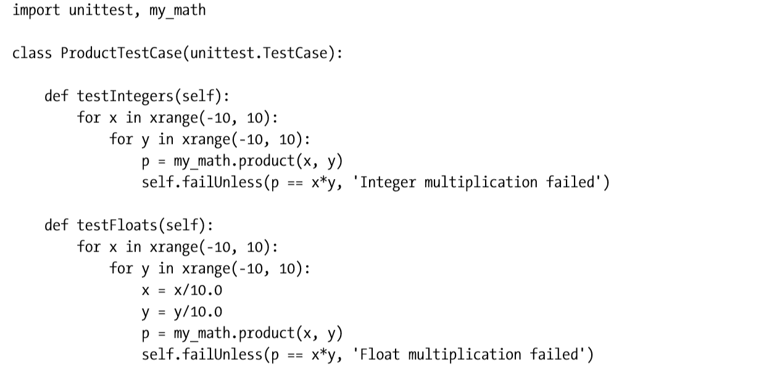
Unit Test Example
Notes:
Maybe write the actual function in class and run the test
Write the product method in class and demonstrate passing/failing test.

Slide 10
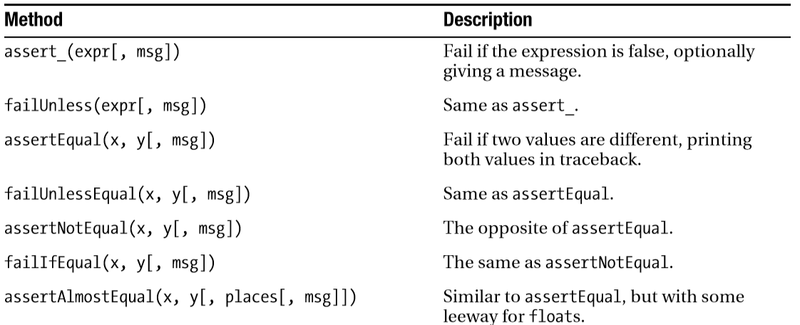
Some Useful TestCase Methods
Notes:
Check the docs link on the handout for more.

Slide 11
Test runners
A test runner is a component which orchestrates the execution of tests and provides the outcome to the user. There are quite a few test runners out there:
Unittest testrunner
Pytest-testrunner
…....
- Collect tests
- Present outcome
- Interact with other tools (e.g. code coverage)
Notes:
Maybe get a picture of what a test coverage looks like.

Slide 12
Let’s have some exercise :)
Suppose you are given a task with the following requirements:
Create a function where given two integers or float, will return their sum
Create a function where, given two integers or float, it will return their differences.
Notes:
Work through the solution with the students using TDD.
Complex numbers?

Slide 13

Test invocation tools
Command line
Continuous integration Servers
Tox - checks if packages install correctly with
- runs your tests for each of the environment
Notes:
Command line - python setup.py tests
- python -m unittest test_module.TestClass
- python -m pytest tests
Travis CI - Perfect for pure Python tests.

Slide 14
Travis (CI)
Online service for CI
Free for public projects
Perfectly embedded with GitHub
Notes:
Use this link to setup travis https://docs.travis-ci.com/user/tutorial/.

Slide 15
Travis (CI) - Configuration steps
Sign up with your Github account.
Choose the repository that you want to test.
Add a .travis.yml file to your repository with your build configuration
The next commit will trigger Travis.
Notes:
Use this link to setup travis https://docs.travis-ci.com/user/tutorial/.

Slide 16
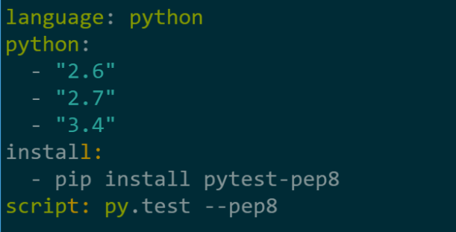
Travis (CI) - Build configuration
Notes:
Use this link to setup travis https://docs.travis-ci.com/user/tutorial/.

Slide 17
Travis (CI)
Click me to setup travis.
Notes:
Use this link to setup travis https://docs.travis-ci.com/user/tutorial/.
Have program that was return earlier where they can add travis ci.

